Slide 1
Wearable project
Embedded electronics, Arduino based

Slide 2
Concept
Bright, attention grabbing clothing
Portable
Functional
Consists of volume activated NeoPixels

Slide 3
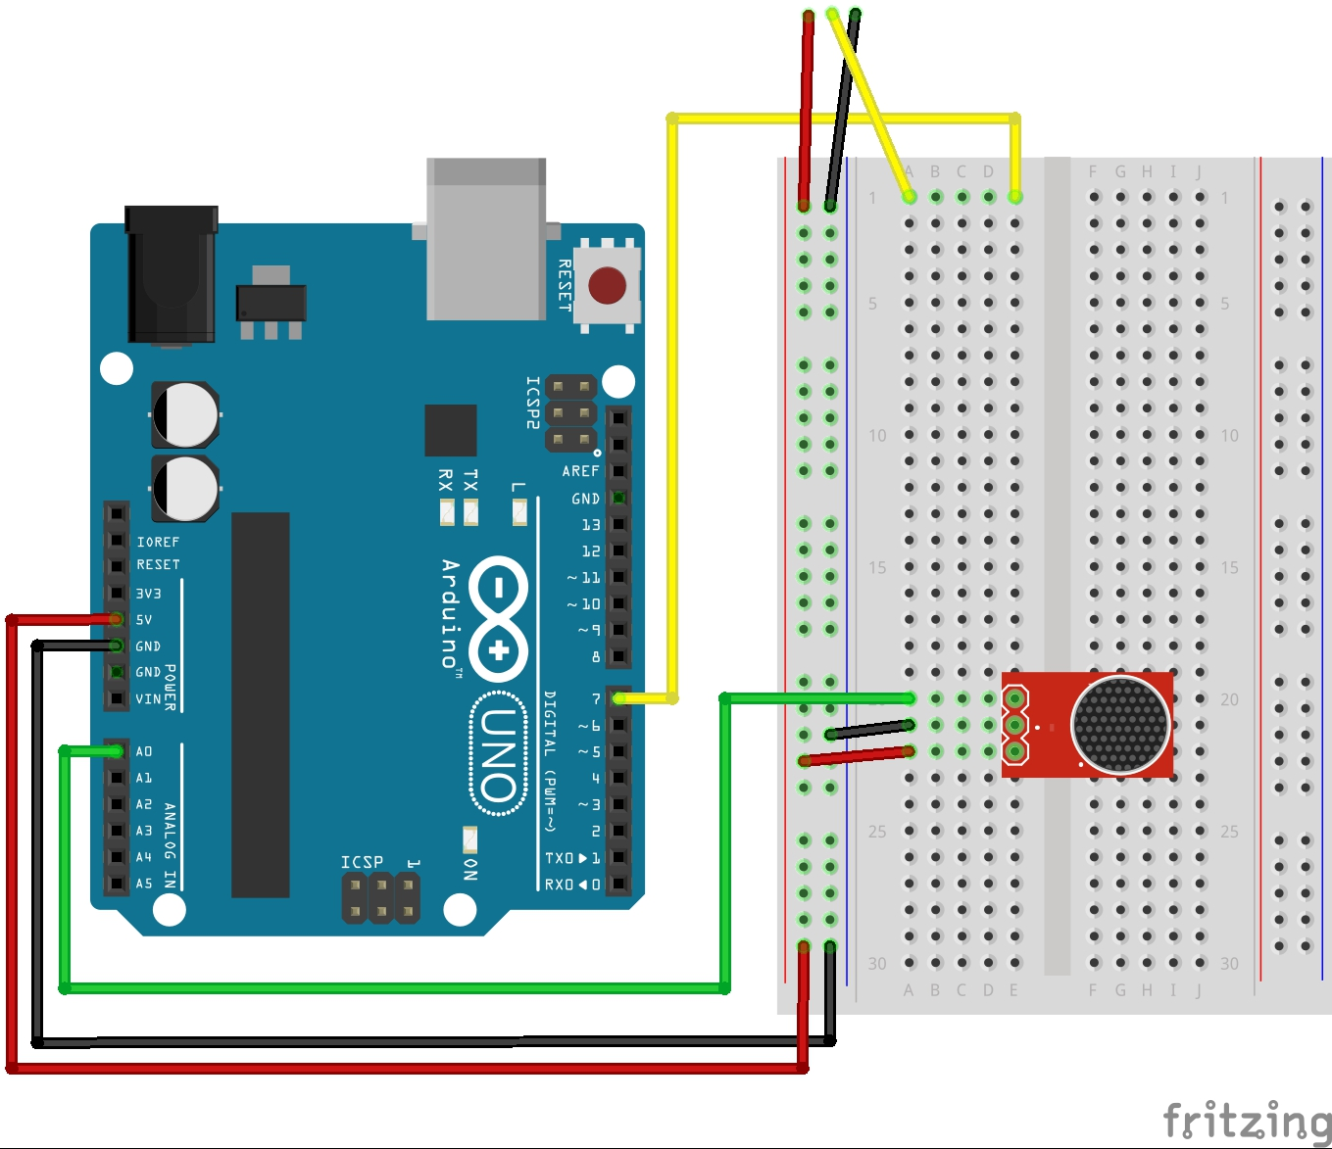
Fritzing diagram

Slide 4
Code
#include <Adafruit_NeoPixel.h>
#define VESTRHSPIN 7 //Right hand side of vest pin number
#define NOPINS 10 //Number of pins in each 'strand'
#define MIC_PIN A0 // Microphone is attached to this analog pin
Adafruit_NeoPixel vestRHSstrip = Adafruit_NeoPixel(NOPINS, VESTRHSPIN, NEO_GRB + NEO_KHZ800);
int history[NOPINS];
int currentPos=0; //Current pointer in history array
void setup() {
memset(history,0,sizeof(history));
vestRHSstrip.begin(); //Set up both sides
vestRHSstrip.setBrightness(30); //Set up brightness
vestRHSstrip.show(); //Initialize all pixels to 'off'
rainbowCycle(5); //Do something pretty for startup
}
Initialization

Slide 5
Code
uint8_t i;
int n;//Raw data from microphone
n = analogRead(MIC_PIN); //Read value from Microphone
//Rotate around history, add one and flick back to zero if need be
currentPos++;
currentPos%=NOPINS;
history[currentPos]=n; //Store current reading in history
for (i=0;i<NOPINS;i++){
//Choose a color based on history
uint32_t colorNum=Wheel(map(history[(i+currentPos)%NOPINS],300,500,0,255)&205);
vestRHSstrip.setPixelColor(i,colorNum);
}
vestRHSstrip.show(); //Push pixel color changes out to the strip
delay(100);
Main loop

Slide 6
Code
// Input a value 0 to 255 to get a color value.
// The colours are a transition r - g - b - back to r.
uint32_t Wheel(byte WheelPos) {
if(WheelPos < 85) {
return vestRHSstrip.Color(WheelPos * 3, 255 - WheelPos * 3, 0);
} else if(WheelPos < 170) {
WheelPos -= 85;
return vestRHSstrip.Color(255 - WheelPos * 3, 0, WheelPos * 3);
} else {
WheelPos -= 170;
return vestRHSstrip.Color(0, WheelPos * 3, 255 - WheelPos * 3);
}
}
Colour wheel

Slide 7
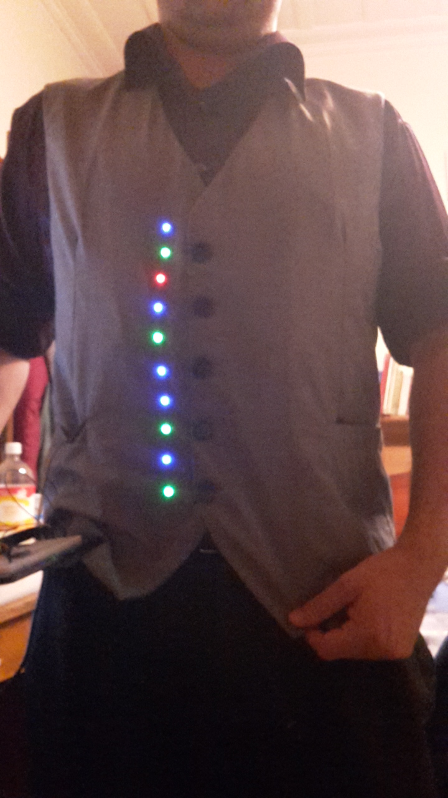
Finished product

